Slide 1
Chapter 2: process management
A process is a program that is loaded into memory and found under executing. i.e an active program.
It refers to a set of instructions currently being processed by the computer processor (CPU).
Associated with each process is its address space which is a list of memory locations from 0 to some maximum that the process can read and write.
The address space contains the executable program, the program's data, and its stack and libraries.
Also associated with each process is a set of resources, commonly including registers and others.

Slide 2
Cont…
Process can create one or more other processes referred to as child processes by a library function called fork() and these processes in turn can create child processes, we quickly arrive at the process tree structure.
A parent process may have multiple child processes, but a child process only one parent process.

Slide 3
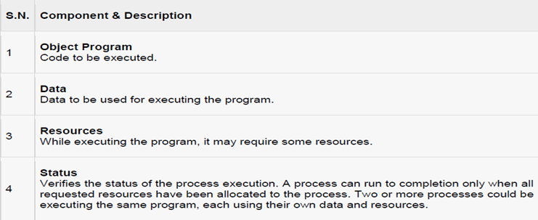
Components of a process

Slide 4
Program vs Process
A program by itself is not a process and is a static entity made up of program statement while process is a dynamic entity.
Program contains the instructions to be executed by processor and does not perform any action by itself.
Program is a group of instructions to carry out a specified task whereas the process is a program in execution.
While a process is an active entity, a program is considered to be a passive one.
One program can invoke multiple processes i.e multiple processes can be a part of the same program.
E.g. you can run two or more copies of most programs - regularly have about 5 copies of running, and each of those are a separate process.

Slide 5
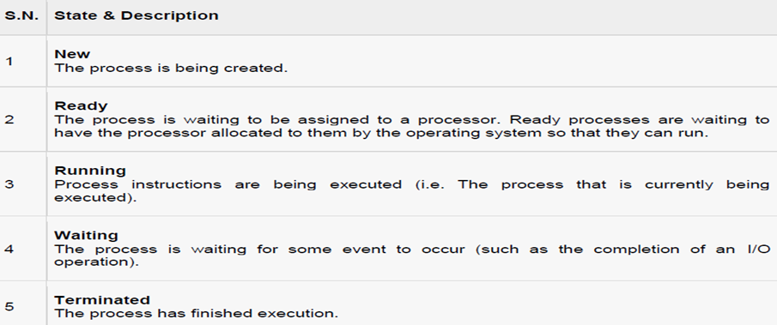
Process States
As a process executes, it changes state. The state of a process is defined as the current activity of the process. Process can have one of the following five states.

Slide 6
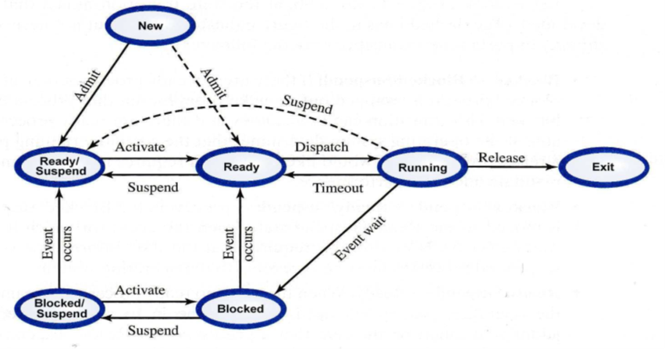
Cont…

Slide 7
Cont…
Ready: The process is in main memory and available for execution.
Blocked: The process is in main memory and waiting an event. A blocked process is a process that requests a lock, but waits for a competing lock to be released by another process.
Blocked/Suspend: The processes in blocked suspended state are in secondary memory. They were initially in the blocked state in main memory waiting for some event but lack of memory forced them to be suspended and gets placed in the secondary memory.
Note: Suspended means directly stopped while Blocked means indirectly stopped by something higher priority in access to some mutually accessible resource.
Ready/Suspend: The process is in secondary memory but is available for execution as soon as it is loaded into main memory.

Slide 8
Characteristics of suspend process
For preventing the execution, process is suspend by OS and not immediately available for execution.
Process may not be removed from the suspended state until the agent orders the removal.
Swapping is used to move all of a process from main memory to disk and When all the process by putting it in the suspended state.

Slide 9
Reasons for process suspension
Swapping: OS needs to release required main memory to bring in a process that is ready to execute.
Because, swapping is a mechanism in which a process can be swapped temporarily out of main memory to secondary storage (disk) and make that memory available to other processes. At some later time, the system swaps back the process from the secondary storage to main memory.
Timing: Process may be suspended while waiting for the next time interval.
Interactive user request: Process may be suspended for debugging purpose by user.
Parent process request: To modify the suspended process or to coordinate the activity of various descendants.

Slide 10
Process Control Block, PCB
PCB is the data structure used by the operating system. Operating system groups all information that needs about particular process.
The Operating system maintains a process control block during the lifetime of the process. The Process control block is deleted when the process is terminated or killed.
Whenever processes changes state, the operating system reacts by placing the process PCB in the list that corresponds to its new state.
Each process is represented in the operating system by a process control block (PCB) also called a task control block.

Slide 11
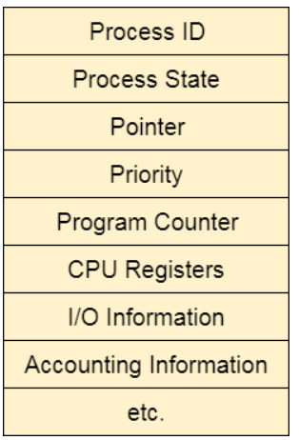
Cont…
There is the following information which is saved in the process control block and is changing with the state of the process witch is called Attributes of a process

Slide 12
Cont…
Attributes which are stored in the PCB are described below.
Process ID:-When a process is created, a unique id is assigned to the process which is used for unique identification of the process in the system.
Program counter :-A program counter stores the address of the last instruction of the process on which the process was suspended.
The CPU uses this address when the execution of this process is resumed.

Slide 13
Cont…
Process State:-The Process, from its creation to the completion, goes through various states which are new, ready, running and waiting.
Priority:-Every process has its own priority. The process with the highest priority among the processes gets the CPU first.
General Purpose Registers:-Every process has its own set of registers which are used to hold the data which is generated during the execution of the process.
List of open files:-During the Execution, Every process uses some files which need to be present in the main memory. OS also maintains a list of open files in the PCB.
List of open devices:-OS also maintain the list of all open devices which are used during the execution of the process.

Slide 14
Difference between Process and Thread:
Process
Thread
Process means any program is in execution.
Multi programming holds the concepts of multi process.
Process is isolated.
Process is called heavy weight process.
Thread means segment of a process or functions run in parallel and good to execute a task in parallel.
We don’t need multi programs in action for multiple threads because a single process consists of multiple threads.
Threads share memory.
A Thread is lightweight as each thread in a process shares code, data and resources.

Slide 15
cont…
In some situations a single application may be required to perform several similar tasks.
E.g. web server accepts client requests for web pages, images, sound, and so forth.
A busy web server may have several of clients concurrently accessing it. If the web server ran as a traditional single-threaded process, it would be able to service only one client at a time.
The amount of time that a client might have to wait for its request to be enormous.
So it is efficient to have one process that contains multiple threads to serve the same purpose.

Slide 16
Cont…
This approach would multi-thread the web-server process, the server would create a separate thread with single application that would listen for client requests when a request was made rather than creating another process it would create another thread to service the request.
Multithreading is a technique in which a process, executing an application, is divided into threads that can run concurrently.
Traditional operating systems are single-threaded systems and Modern operating systems are multithreaded systems.

Slide 17
Inter-Process Communication, Concurrency and Its Problems
The most fundamental task of modern operating systems is management of multiple processes within uniprocessor, multiprocessor or distributed computer systems.
The fundamental design issue in the management of multiple processes is concurrency: simultaneous execution of multiple processes.
Concurrency arises in different contexts
Multiple applications: concurrently running applications
Structured applications: an application structured as a set of concurrent processes (threads)

Slide 18
Inter-process Communication
Related processes that are cooperating to get some job done often need to communicate with one another and synchronize their activities. This communication is called inter-process communication.
There is frequent interaction among concurrently running processes in three ways .
Competition for Resources
Cooperation by Sharing Resources
Cooperation by Communication

Slide 19
Competition for Resources
It occurs when independent processes that are not intended to work together compete for the use of the same resource, e.g. printer
There is no exchange of information between competing processes and they are unaware of each other
Cooperation by Sharing Resources
It occurs when processes that are not necessarily aware of each other use and update shared data without reference to other processes but know that other processes may have access to the same data.

Slide 20
Cooperation by Communication
It occurs when various processes communicate with each other, for instance with message passing in order to provide a way to synchronize or coordinate their various activities.
Processes are aware of each other directly

Slide 21
Concurrency Problems
Race Condition, is a situation that occurs when two or more processes are reading or writing into some shared data and the final result depends on who runs precisely when.
E.g. Printer Spooler: when a process wants to print a file, it enters the file name in a special spooler directory.
There are two globally shared variables
Outfile: points to the next file to be printed
Infile: points to the next free slot in the directory

Slide 22
Cont…
There are some files in the spooler directory and assume the current value of infile is 7 and that of outfile is 3
Assume that simultaneously process A and process B decide they want to queue a file for printing
Process A reads infile and stores the value 7 in its local variable (x=infile)
An interrupt occurs and the CPU decides that process A has run long enough so it switches to process B
Process B reads infile and stores the value 7 in its local variable (y=infile)
Process B stores the name of its file in slot 7 and adjusts infile to be 8
Eventually process A runs again, it checks x and finds 7 there, and writes its file name in slot 7, erasing the name process B just put there, it updates infile to be 8
The printer daemon will now print the file of process A, process B file will never get any output.

Slide 23
Deadlock
A deadlock is a condition where two or more tasks are waiting for each other in order to be finished but none of the task is willing to give up the resources that other task needs.
A set of blocked processes each holding a resource and waiting to acquire a resource held by another process in the set.
It is the permanent blocking of a set of processes that either compete for system resources or communicate with each other.
In this situation no task ever gets finished and is in waiting state forever.
Process P1 holds resource R2 and require R1 while process P2 holds resource R1 and require R2.

Slide 24
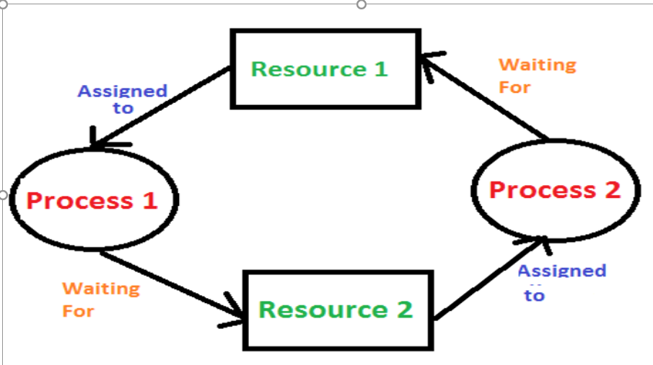
Cont…
.

Slide 25
Deadlock Characterization
Low resource utilization; starvation possible. Starvation refers to the situation in which a process is ready to execute but is continuously denied access to a processor in deference to other processes.
Hold and wait: a process holding at least one resource is waiting to acquire additional resources held by other processes.
No pre-emption: a resource can be released only voluntarily by the process holding it.
Circular wait: there exists a set {P0, P1, …, Pn} of waiting processes such that P0 is waiting for a resource that is held by P1, P1 is waiting for a resource that is held by P2, …, Pn–1 is waiting for a resource that is held by Pn.

Slide 26
Deadlock Prevention
Hold and Wait – must guarantee that whenever a process requests a resource, it does not hold any other resources. Allow process to request resources only when the process has none.
If a process that is holding some resources requests another resource that cannot be immediately allocated to it, then all resources currently being held are released.
Process will be restarted only when it can regain its old resources, as well as the new ones that it is requesting.
Mutual Exclusion –It is the ability to exclude all other processes from using a shared variable or file while one process is using it. Part of a program where shared resource (critical resource) is accessed is called critical region or critical section.
The fundamental strategy for implementing mutual exclusion is avoiding the situation where no two processes could ever be in their critical regions at the same time.

Slide 27
Requirements that should be met while implementing mutual exclusion.
1. No two processes may be simultaneously in their critical regions.
2. No assumptions may be made about speed or the number of processors.
3. No process should have to wait forever to enter its critical region.

Slide 28
Processor Scheduling
Processor Scheduling is the means by which operating systems allocate processor time for processes.
It can be implemented on uniprocessor systems (Uniprocessor Scheduling), Multiprocessor systems (Multiprocessor Scheduling), Real-time systems (Real-time Scheduling)
The operating system makes three types of scheduling decisions with respect to execution of processes:

Slide 29
1. Long-term Scheduling
The decision to add to the pool of processes to be executed
It determines when new processes are admitted to the system
It is performed when a new process is created and admitted
a. New → Ready
b. Blocked/Suspend → Ready/Suspend

Slide 30
2. Medium-term Scheduling
The decision to add to the number of processes that are partially/fully in main memory
It determines when a program is brought partially or fully into main memory so that it may be executed
It is performed when swapping is done
a. Ready/Suspend →Ready
b. Blocked/Suspend → Blocked

Slide 31
3. Short-term Scheduling
It determines which ready process will get processor time next
It is performed when a ready process is allocated the processor (when it is dispatched)
Ready → Running
Part of the operating system that makes scheduling decision is called scheduler and the algorithm it uses is called scheduling algorithm.
In the case of short term scheduling, the module that gives control of CPU to the process selected by the scheduler is called dispatcher.

Slide 32
Requirements that should be met by short-term scheduling algorithms.
Response Time: Response time is the time spent between the ready state and getting the CPU for the first time. The time from submission of request until the response begins to be received. or The difference between the arrival time and the time at which the process first gets the CPU. Response time = Time at which the process gets the CPU for the first time - Arrival time.
Turn Around Time: The total amount of time spent by the process from its arrival to its completion.
Throughput: The number of processes completed per unit time (jobs / second). it should be maximized
Efficiency/CPU Utilization: The percentage of time that the CPU is busy should be maximized
Dispatch latency – time it takes for the dispatcher to stop one process and start another running.

Slide 33
Cont…
Waiting time – sum of the periods spent waiting in the ready queue or The Total amount of time for which the process waits for the CPU to be assigned. In short ,waiting time is the total time taken by the process in the ready state.
Service time -The time required by a device to handle a request.
Burst Time- is the total time taken by the process for its execution on the CPU.
Arrival Time-the time at which the process enters into the ready queue is called the arrival time.
Queuing time -Time on a queue waiting for service from the device.
Residence time- The time spent by a request at a device.
Residence time = service time + queuing time.

Slide 34
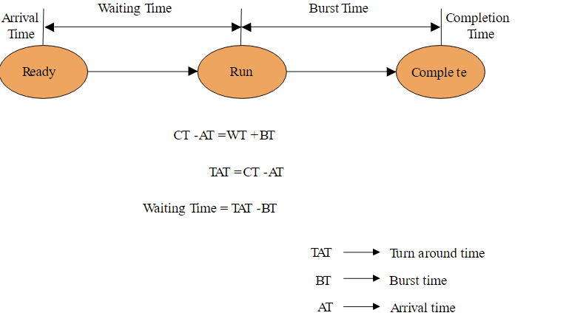
Various Times related to the Process

Slide 35
Two main characteristics of short-term scheduling algorithms
1.Selection function
It determines which process, among ready processes, is selected for execution. Which may be based on
­Priority
­Resource requirement
­Execution behavior: time spent in system so far (waiting and executing), total service time required by the process.

Slide 36
2.Decision mode
It specifies the instants in time at which the selection function is exercised.
There are two types of decision modes
1. Preemptive
The strategy of allowing processes that are logically runnable to be temporarily suspended and be moved to the ready state.
Events that may result pre-emption are arrival of new processes, occurrence of an interrupt that moves blocked process to ready state and clock interrupt.

Slide 37
­ 2.Non-Preemptive
Run to completion method: once a process is in running state, it continues to execute until it terminates or blocks itself to wait for some event
Simple and easy to implement
Used in early batch systems
It may be well reasonable for some dedicated systems
Efficiency can be attained but response time is very high

Slide 38
Scheduling Algorithms (Short-term Scheduling Algorithms)
CPU scheduling deals with the problem of choosing a process from the ready queue to be executed by the CPU.
The following CPU scheduling algorithms will be described:
First-Come, First-Served (FCFS).
Shortest-Job-First (SJF).
Priority.
Round-Robin (RR).
Multilevel Queue.
Multilevel Feedback Queue.

Slide 39
First-Come, First-Served (FCFS) Scheduling
First Come First Served (FCFS) is a Non-Preemptive scheduling algorithm. FIFO (First In First Out) strategy assigns priority to process in the order in which they request the processor.
The process that requests the CPU first is allocated the CPU first. This is easily implemented with a FIFO queue for managing the tasks.
As the process come in, they are put at the end of the queue and is the simplest CPU scheduling algorithm.
The process that requests the CPU first is allocated the CPU first.
The average waiting time under FCFS is long.

Slide 40
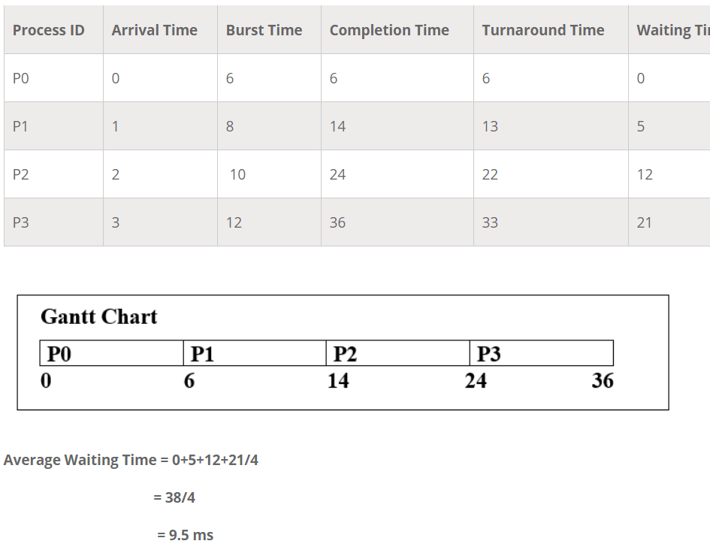
Example 1

Slide 41
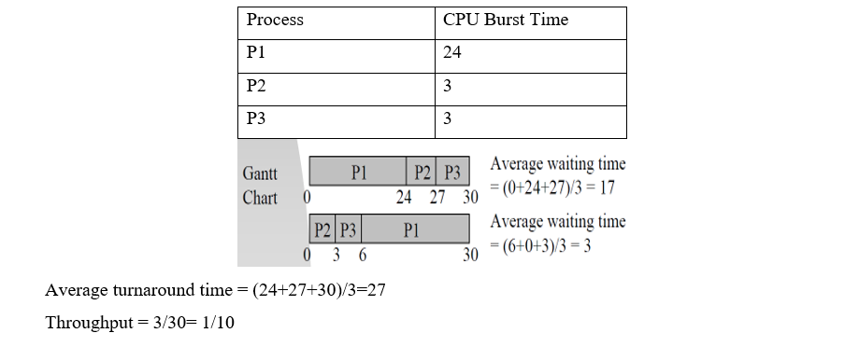
Example 2:

Slide 42
B. Shortest Job First Scheduling (SJFS)
Process with the shortest processing time (CPU burst) is selected first.
Its selection function is execution time and it uses both non preemptive and Preemptive scheduling/decision mode.
Optimal for minimizing queuing time.
Associate with each process the length of its next CPU burst. Use these lengths to schedule the process with the shortest time.

Slide 43
Cont…
Non pre-emptive – once CPU given to the process it cannot be preempted until completes its CPU burst.
Preemptive – if a new process arrives with CPU burst length less than remaining time of current executing process, then previous process preempt.
This scheme is known as the Shortest-Remaining-Time-First (SRTF).
SJF is optimal – gives minimum average waiting time for a given set of processes.

Slide 44
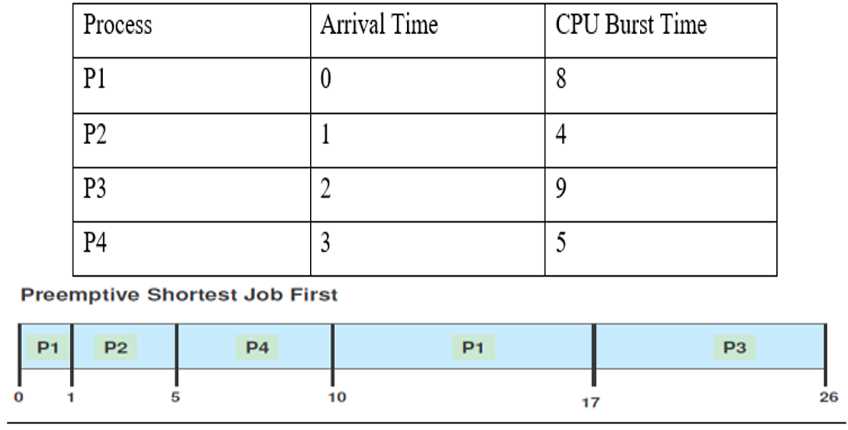
Example 1

Slide 45

Cont…
Average waiting time: (0-0)+(1-1)+(5-3)+(10-1)+(17-2)=26/4=6.5
ATAT=CT-AT OR
TAT= WT+BT
((5-1)+(10-3)+(17-0)+(26-2))/4=52/4=13
26+26=52

Slide 46
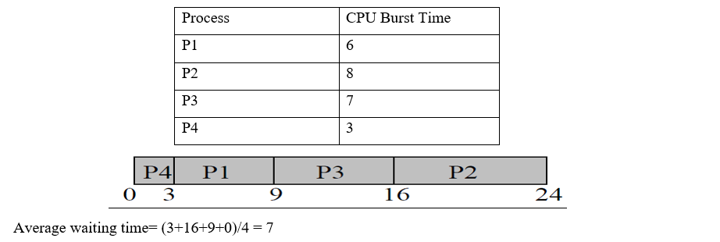
Example2:

Slide 47
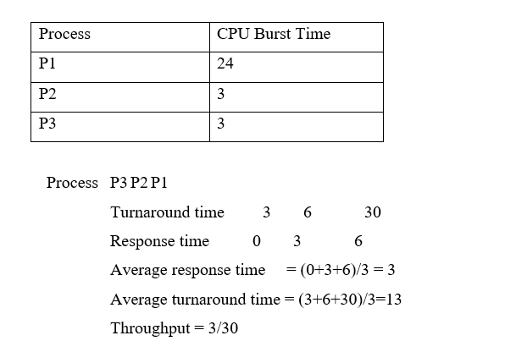
Example 3:

Slide 48
There are two schemes for SJF
Non pre-emptive – once CPU given to the process it cannot be pre-empted until completes its CPU burst.
Pre-emptive – if a new process arrives with CPU burst length less than remaining time of current executing process, pre-empt.
This scheme is known as the Shortest-Remaining-Time-First (SRTF).

Slide 49
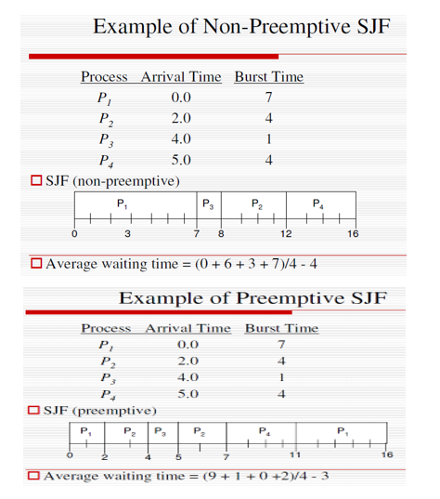
Cont…

Slide 50
C. Priority Scheduling
Assign each process a priority and then schedule highest priority first. All processes within same priority are FCFS.
Priority may be determined by user or by some default mechanism. The system may determine the priority based on memory requirements, time limits, or other resource usage.
Starvation occurs if a low priority process never runs. Solution: build aging into a variable priority.
A priority number (integer) is associated with each process
The CPU is allocated to the process with the highest priority (e.g smallest integer ≡ highest priority).

Slide 51
Priority may be:
Pre-emptive: CPU scheduling is invoked whenever a process arrives at the ready queue, or the running process relinquishes the CPU.
Non preemptive: CPU scheduling is invoked only when the running process give up the CPU.
SJF is a priority scheduling where priority is the predicted next CPU burst time.

Slide 52
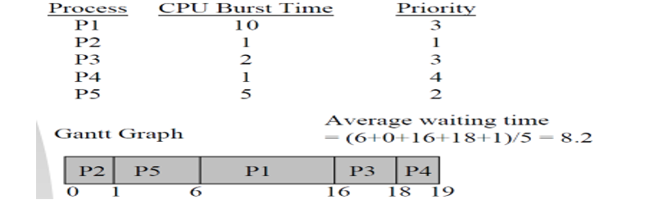
Example

Slide 53
D. Round-Robin Scheduling (RR)
Round Robin is a CPU scheduling algorithm where each process is assigned a fixed time slot in a cyclic way.
It is similar to FCFS except that pre-emption is added to switch between processes and designed for time sharing systems.
Each process gets a small unit of CPU time (time quantum or time slice) usually 10-100 milliseconds.
After this time has elapsed, the process is pre-empted and added to the end of the ready queue.
That is, after the time slice is expired an interrupt will occur and a context switch.

Slide 54
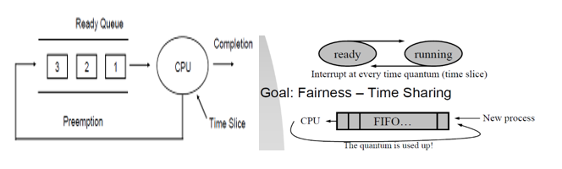
Cont…

Slide 55
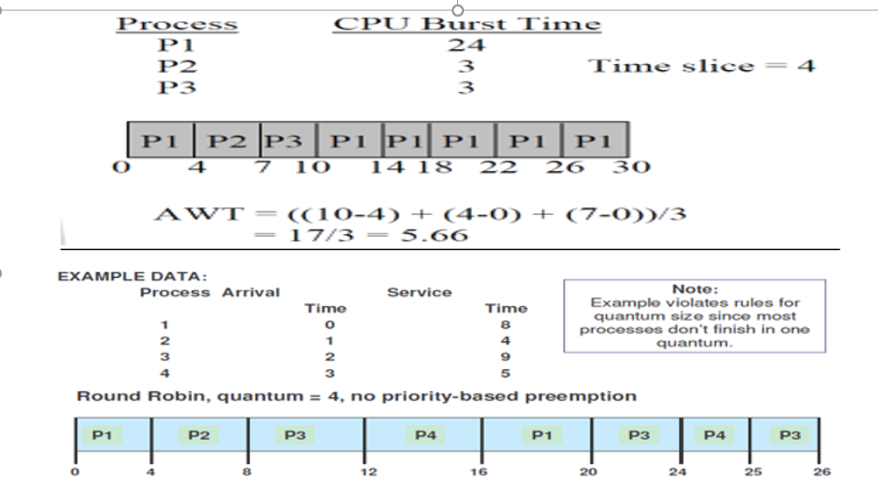
Example

Slide 56
E. Multilevel Queue Scheduling
Multilevel queue scheduling is used when processes in the ready queue can be divided into different classes where each class has its own scheduling needs.
In a multilevel queue-scheduling algorithm, processes are permanently assigned to a queue on entry to the system. Processes do not move between queues.
For instance, foreground or interactive processes and background or batch processes are commonly divided.
Foreground and background processes. Processes that require a user to start them or to interact with them are called foreground processes.
Background processes .Processes that are run independently of a user are referred to as background processes.
Foreground and background processes have different time requirements and hence will have different scheduling needs. In this case, multilevel queue scheduling will be used.
These two classes have different scheduling needs. For this kind of situation Multilevel Queue Scheduling is used.
For example, let us take three different types of processes System processes, Interactive processes, and Batch Processes. All three processes have their own queue.

Slide 57
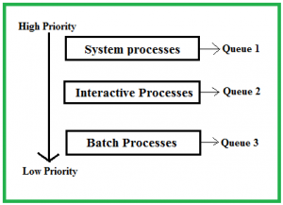
Cont…

Slide 58
F. Multilevel Feedback Queue
This Scheduling is like Multilevel Queue(MLQ) Scheduling but in this, process can move between the queues. This is the reason to called Multilevel Feedback Queue.
Multilevel Feedback Queue Scheduling keeps analyzing the behavior (time of execution) of processes and according to which it changes its priority.
Whereas the multilevel queue algorithm keeps processes permanently assigned to their initial queue assignments.
The a multilevel feedback queue extends standard algorithms with the following design requirements:
Separate processes into multiple ready queues based on their need for the processor.
Give preference to processes with short CPU bursts.
Give preference to processes with high I/O bursts. (I/O bound processes will sleep in the wait queue to give other processes CPU time.)
The shift is dependent upon the CPU bursts of prior time-slices.
If a process uses too much CPU time, it will be moved to a lower-priority queue.
If a process is I/O-bound or an interactive process, it will be moved to a higher-priority queue.
If a process is waiting too long in a low-priority queue and starving, it will be aged to a higher-priority queue.
If a process uses too much CPU time, it will be moved to a lower-priority queue.

Slide 59
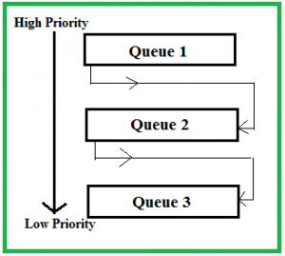
Cont…

Slide 60
Cont…
Suppose that queues 1 and 2 follow round robin with time quantum 8 and 16 respectively and queue 3 follows FCFS. One of the implementations of Multilevel Feedback Queue Scheduling is as follows:
If any process starts executing then firstly it enters queue 1.
In queue 1, the process executes for 8 unit and if it completes in these 8 units or it gives CPU for I/O operation in these 8 units and the priority of this process does not change.
If a process that is in queue 1 does not complete in 8 units then its priority gets reduced and it gets shifted to queue 2.
Above points 2 and 3 are also true for processes in queue 2 but the time quantum is 16 units. Generally, if any process does not complete in a given time quantum then it gets shifted to the lower priority queue.
After that in the last queue, all processes are scheduled in an FCFS manner.
It is important to note that a process that is in a lower priority queue can only execute only when the higher priority queues are empty.
Any running process in the lower priority queue can be interrupted by a process arriving in the higher priority queue.

Slide 61
G. Multiple-Processor Scheduling
Multiple processor scheduling focuses on designing the system's scheduling function, which consists of more than one processor.
Multiple CPUs share the load (load sharing) in multiprocessor scheduling so that various processes run simultaneously. In general, multiprocessor scheduling is complex as compared to single processor scheduling.
The multiple CPUs in the system are in close communication, which shares a common bus, memory, and other peripheral devices. So we can say that the system is tightly coupled. These systems are used when we want to process a bulk amount of data.
Multiprocessor systems may be heterogeneous (different kinds of CPUs) or homogenous (the same CPU).

Slide 62

The end

